Slide 1
Grand Central Dispatch
Prepared for Cocoaheads DC
Hardip Singh
7/7/2016

Slide 2

Me
DC Native, Born And Raised
Long Time Web, back-end, and Enterprise Integration Engineer
Doing iOS development since 2009
Organizer of Cocoaheads DC since 2011
Hands-On development manager of iOS and Android at The Washington Post

Slide 3

What is Grand Central Dispatch (GCD)?
Technology developed by apple that provides support for concurrent code execution on multicore hardware
Moves management of the thread pool closer to the OS.
The Functionality is exposed through a simple, lightweight C API.
The implementation is provided by libdispatch, which was open sourced under the Apache license in 9/2009.
GCD released with Mac OSX 10.6 and was first available in iOS in iOS 4.0

Slide 4
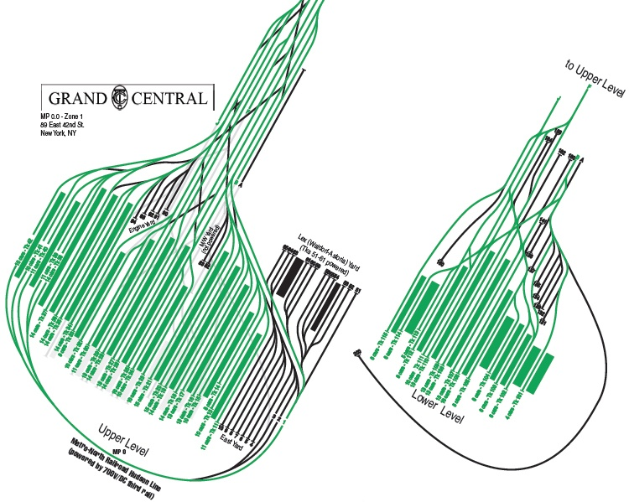
the name
The name Grand Central Dispatch is in reference to Grand Central Terminal, the busiest train station in the U.S., which is in NYC.

Slide 5


Benefits of Using GCD
Cleaner, simpler, more stable code by abstracting low level threads from the developer
Improves app performance by allowing you to run costly tasks in the background
Reduces the memory penalty your application pays for storing thread stacks in the application’s memory space.
Provides a more efficient alternative to traditional synchronization primitives (i.e. locks, semaphores)

Slide 6
Major Features
Dispatch Sources
Dispatch I/O
Dispatch Data Objects
Managing Time
Dispatch Queues
Dispatch Groups
Dispatch semaphores
Dispatch Objects
Barriers

Slide 7


Dispatch Queues
Serial Queues vs Concurrent Queues
The Main Queue is a global serial dispatch queue (dispatch_get_main_queue())
getting a global queue: dispatch_get_global_queue(dispatch_queue_priority_high, 0)
Global concurrent dispatch queues (in order of priority):
DISPATCH_QUEUE_PRIORITY_HIGH
DISPATCH_QUEUE_PRIORITY_DEFAULT
DISPATCH_QUEUE_PRIORITY_LOW
DISPATCH_QUEUE_PRIORITY_BACKGROUND

Slide 8
Creating Custom Dispatch queues
Create a custom concurrent queue:
dispatch_queue_create("com.cocoaheads.gcdTalk.concurrent", DISPATCH_QUEUE_CONCURRENT)
Create a custom serial queue:
dispatch_queue_create("com.cocoaheads.gcdTalk.serial", dispatch_queue_serial)

Slide 9
Dispatch_sync vs dispatcH_async
Use dispatch_sync to block until all tasks sent to the queue are finished
Use dispatch_async to let the execution continue while the tasks are executing
..

Slide 10
Let’s See Some Code!

Slide 11
Dispatch_once / dispatch_after
Dispatch_once can be used to ensure that a block of code only runs once
Dispatch_after can be used to run a block after a time delay

Slide 12
More CODE!

Slide 13
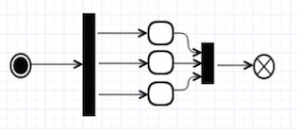
Dispatch Groups
used to monitor a set of tasks for completion.
can be useful since it is possible that the tasks were synced, asynced, serialized, parallelized and can even be executed on different threads
Use dispatch_group_async to associate multiple tasks to a group
use dispatch_group_wait to wait for completion of tasks that enter the group
use dispatch_group_notify to execute a closure asyncronously in a specified queue when the group’s tasks have all been completed

Slide 14
Dispatch_group_enter / dispatch_group_leave
Dispatch_group_async falls short for the case where you have async completion closures.
use dispatch_group_enter to add items to the group, and dispatch_group_leave to remove items from the group.

Slide 15
Even More Code!

Slide 16
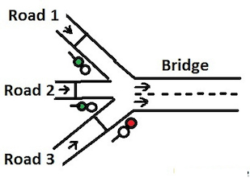
Dispatch semaphores
Semaphore is a method of controlling access to a resource in a multithreaded environment
Gcd dispatch semaphores provide a more efficient alternative to traditional semaphores since calls to the kernel are only made when the calling thread needs to be blocked

Slide 17
Yay, More Code!

Slide 18

barriers
A dispatch barrier allows you to create a synchronization point within a concurrent dispatch queue.
Tasks after the barrier will not execute until the barrier block is hit and executed.

Slide 19
Show us the code already!

Slide 20


Dispatch sources
dispatch sources can be used to trigger code blocks for specific low-level system events.
Dispatch sources can be suspended, resumed and cancelled
timer sources can be used to create timer based events
Signal sources can be used to monitor and react to unix signals
Descriptor sources can be used to monitor file and socket based events (i.e: data is ready for reading/writing; files are created/updated/renamed/deleted)
process sources can be used to monitor process related events (i.e: exit, fork, exec)
Mach sources (i.e: mach port read/send state)
Custom sources can be also created

Slide 21


Slide 22
Dispatch i/O / Dispatch Data
dispatch I/O can be used to perform asynchronous read/write operations on file descriptors. Both stream based and random access methods are supported.
Dispatch data can be used as a data container for memory based data buffers. Clients accessing the data buffer see it as a contiguous block of memory, but internally the buffer may be comprised of multiple discontiguous blocks of memory.

Slide 23
Wait, more code?!?

Slide 24
Gotchas
Just because you can use GCD to accomplish something, doesn’t mean that you should. GCD is not always the easiest answer to solving a problem.
multithreading in general is tricky. you can get into major trouble if you don’t know what you are doing (thread contention issues, deadlocks, performance degradation)
be aware of thread limits (512 blocks to a queue, hardware defined limits)
Always go back to the main thread to do any UI Updates. Not doing so can result in crashes dispatch_async(dispatch_get_main_queue(),{ // update ui here })

Slide 25
Learn More
https://developer.apple.com (Documentation & Videos)
https://www.raywenderlich.com/60749/grand-central-dispatch-in-depth-part-1
https://www.raywenderlich.com/79149/grand-central-dispatch-tutorial-swift-part-1

Slide 26



Contact Me
@Hardip_Singh on Twitter
www.linkedin.com/in/hardipsingh
hardip@cocoaheadsdc.org

Slide 27

Questions?

